Slide 1
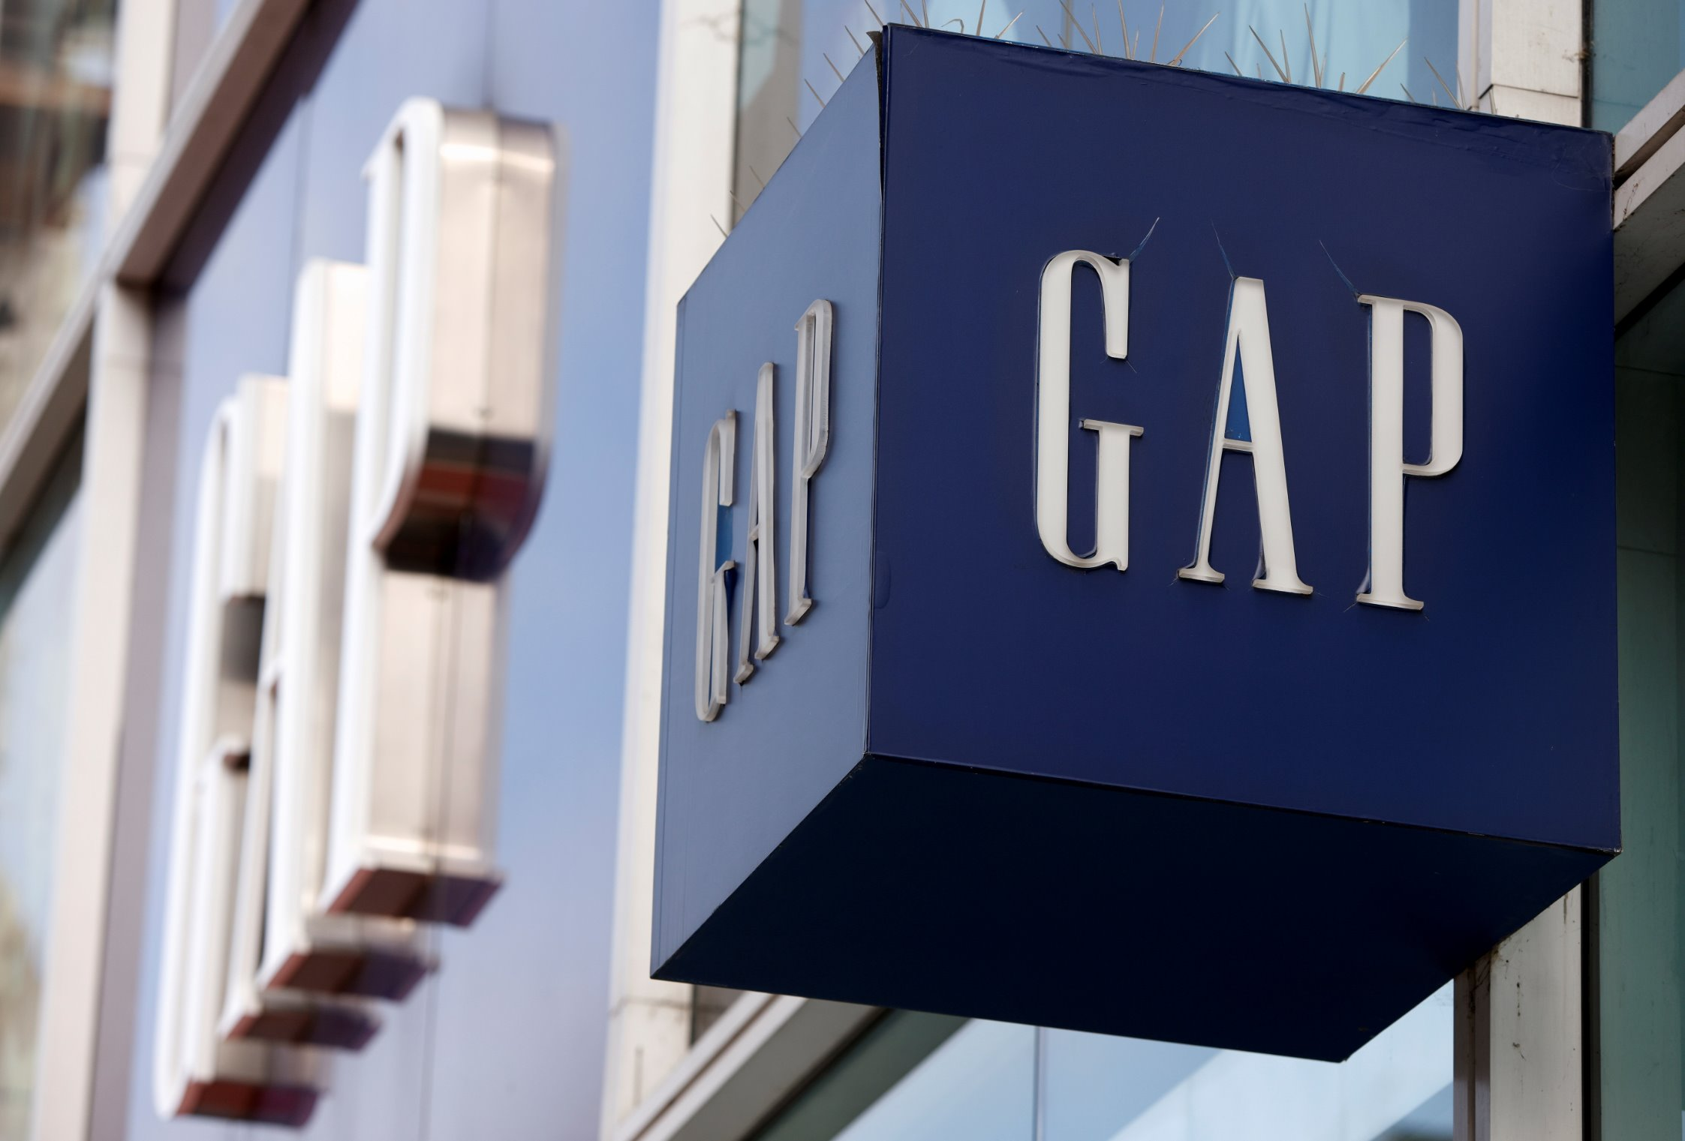
GAP Case Analysis
Members:​
Chhaya Tundwal​
Tirth Ashok Patel​
Tomas Alberto Mujica​

Slide 2

Business Problem
Gap Inc. faced two years of declining sales, having struggling performance impacted by competition and a shift to e-commerce.
Key Tensions
Creative vs Data-Driven Approach​
Slow Adaptation to Short Production Cycles​
Changing consumer behaviour
Fast Fashion
Analyzing pricing strategies for three brands

Slide 3
Approach of the business problem
Creating the problem statement
Data Collection and Analysis :
Profit and Sales (before and after implementing data driven process)
Trends and Review Analysis
Impact of Big Data Marketing
How did Gap leverage Big Data and predictive analytics to not only optimize operations but also predict consumer trends and rejuvenate its brand, without sacrificing the creative edge that has historically defined its identity.
Social Media Analysis
Personalized Marketing Campaigns
Improved Demand Forecasting
Enhanced Customer Retention

Slide 4
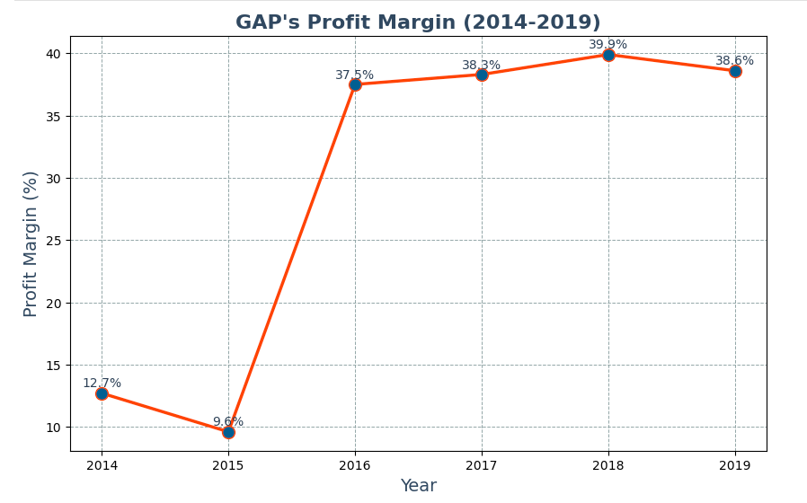
Creative Directors v/s Big data Analysis
Scraped data for 10K-filings and the Annual Reports of Gap Inc. from year 2014 – 2019.
Details of Profitability and net sales :
1. Profit Margin :
In 2015, the Profit margins were under pressure due to high inventory levels, markdowns, and weak sales in core brands.
Predictive analytics began to play a role in better inventory management, helping reduce costs associated with excess inventory. This improved the profit margin.

Slide 5
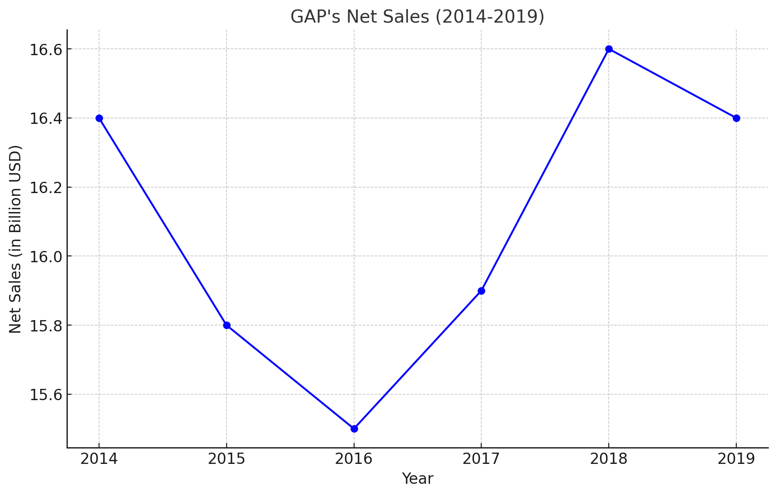
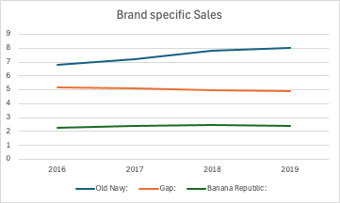
2.Revenue Growth
We can see that the net sales of Gap Inc. were the lowest in 2016, as Peck became the CEO and brought the predictive analysis strategy the net sales increased as they improved inventory management, enhanced customer experience, and improved marketing.

Slide 6








Data Collection & Analysis
Social Media Trends
Track social media trends, hashtags, and styles.
Google Trends Data
Identify search interest in specific clothing features.
Identify emerging fashion themes through social listening.
Competitor Data analysis
Monitor competitors’ products, pricing strategies, and customer reviews.
GAP E-commerce Review Data
Conduct sentiment analysis on customer reviews from GAP Inc.’s e-commerce platforms.
Analyze trending keywords and consumer preferences.
Compare performance and identify areas for differentiation.
Evaluate customer feedback to improve online shopping experience.

Slide 7
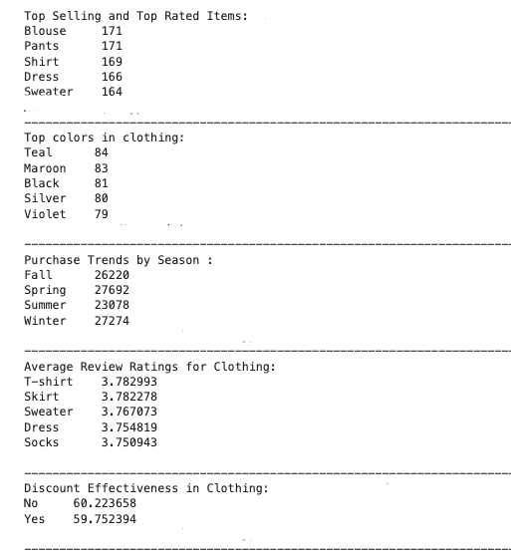
Google Trends Data Analysis
Top Selling and Top-rated Items:
Blouses, Pants, Shirts, Dresses, T-shirts, Skirts, and Sweaters drive revenue and customer satisfaction.
Popular Colors:
Focus on Teal, Maroon, Black, Silver, and Violet, as they align with customer preferences.
Seasonal Purchase Trends:
Spring and Winter have the highest sales, making them key seasons for promotions.
Discount Effectiveness:
Discounts slightly lower purchase amounts but can drive volume during key sales periods.

Slide 8
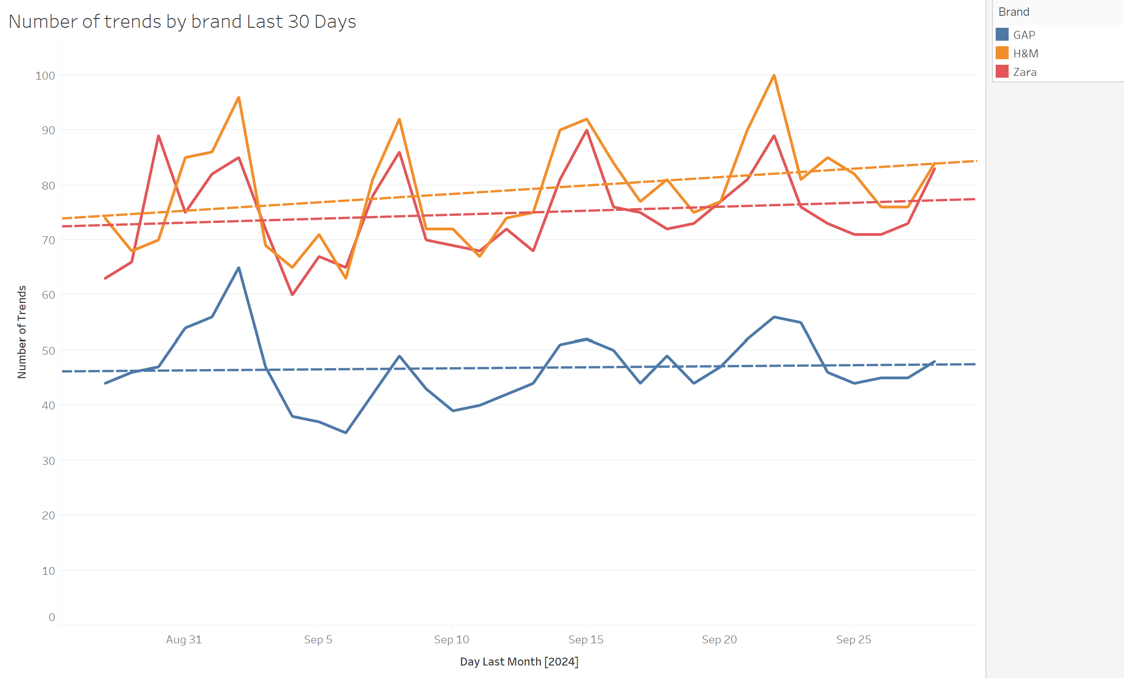
Competitor Zara & HM Trends Analysis
From scraping the data of the trend's history of Gap’s competitors (Zara & HM) we can measure and control:
Sales trends
Market Positioning
Impact of strategies implemented
Optimize product offerings

Slide 9
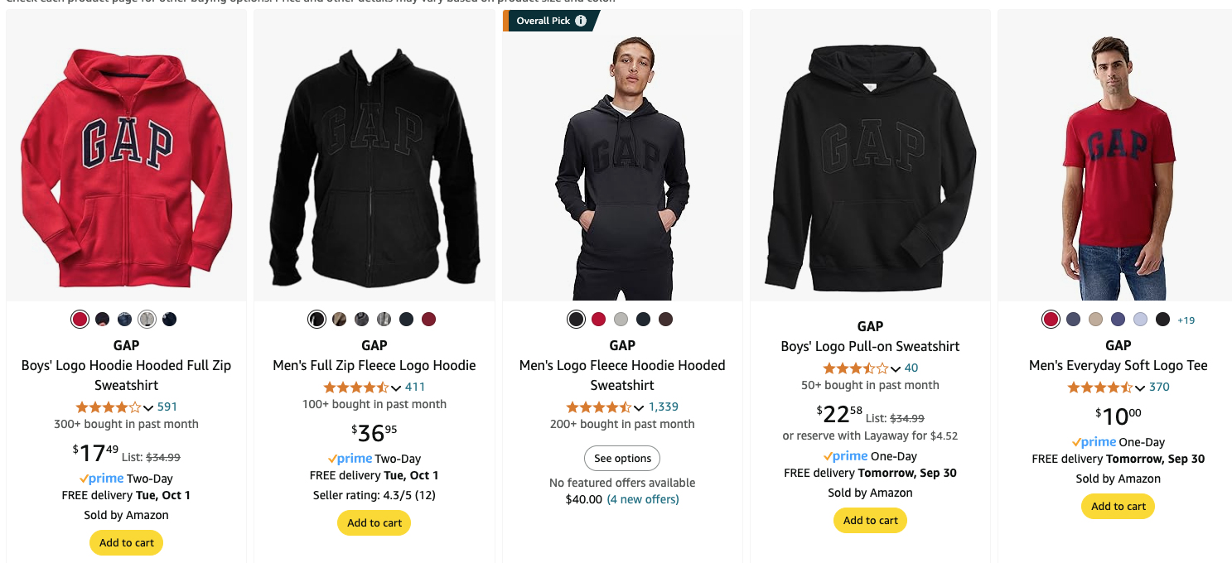
Amazon Listing Analysis
We collected data that includes Product Name, Price, Rating & Number of reviews
This can help GAP with analyzing potential products with low number of reviews & rating and can replace it another relevant product
This can help GAP with being relevant and up to date with the current trends and also ensure fast production cycles for their products
Check current trends from competitors
Replace the product with another in demand product
Repeat the process
Identify products with low number of reviews and rating

Slide 10
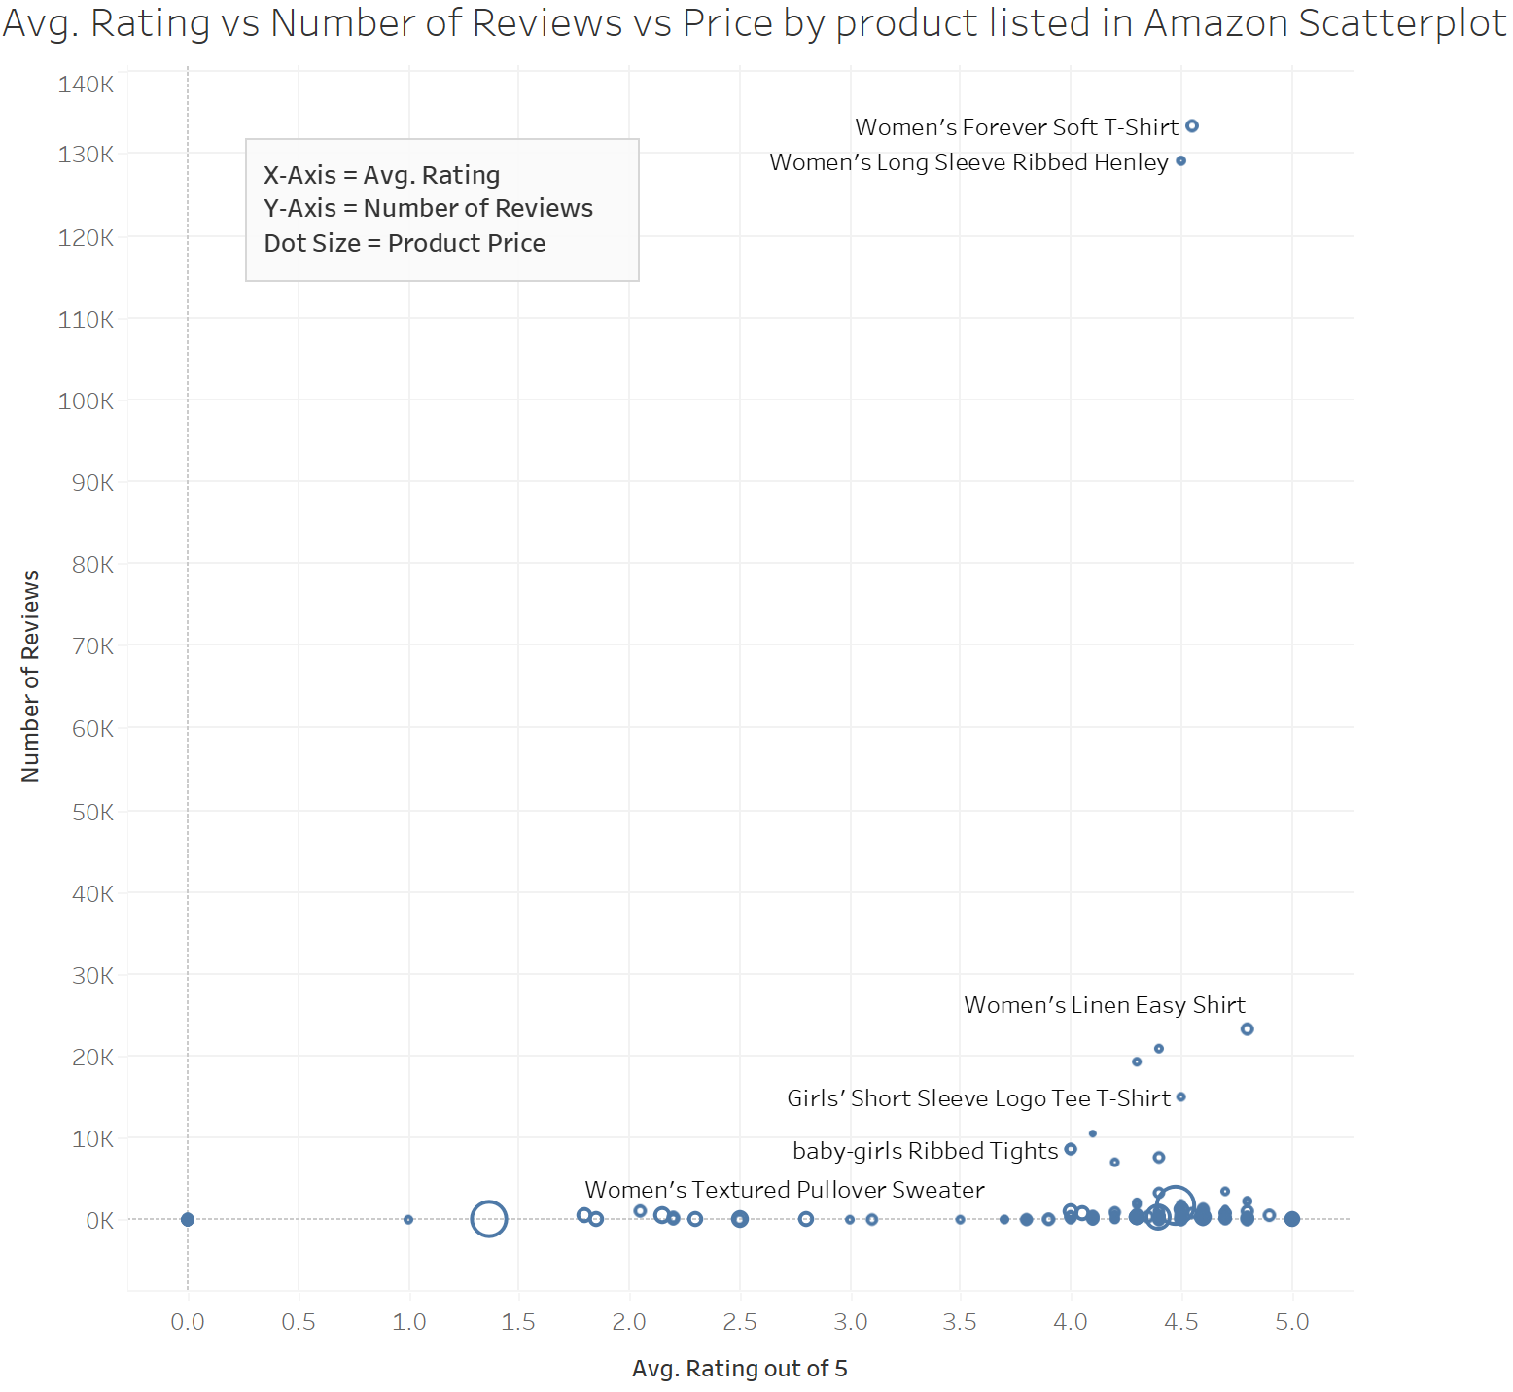
Amazon Listing Comparing Reviews and Ratings
We can observe that certain women’s products stand out above the others due to their high average ratings and number of reviews.
We can also identify women-centric products that are not as popular but are highly rated by customers. These items could be enhanced with targeted marketing campaigns to increase visibility.
This can also help GAP understand the correlation between ratings & no. of reviews and focus on specific marketing campaigns for them

Slide 11
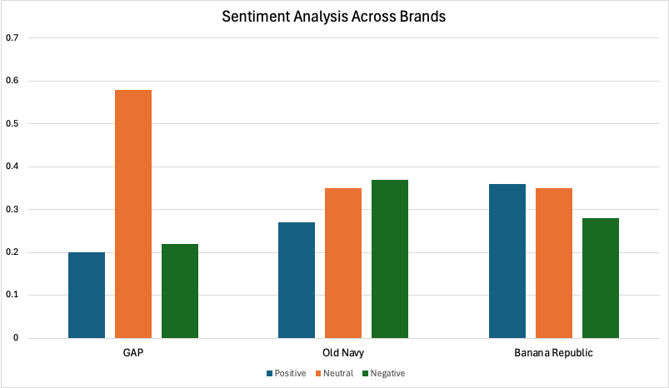
Reddit Analysis
Scrapped Post Titles and Description from various subreddits with mentions of either GAP, Old Navy & Banana Republic
Conducted Sentiment Analysis using MS Azure API to see what is the overall sentiment for each brand
Conclusion:
This form of big data approach can be followed by all 3 brands, to understand the sentiment of customers and improve the customer experience as well.
Brands can also lookup for keywords that people are talking about the most, which can eventually lead to trend analysis as well.

Slide 12

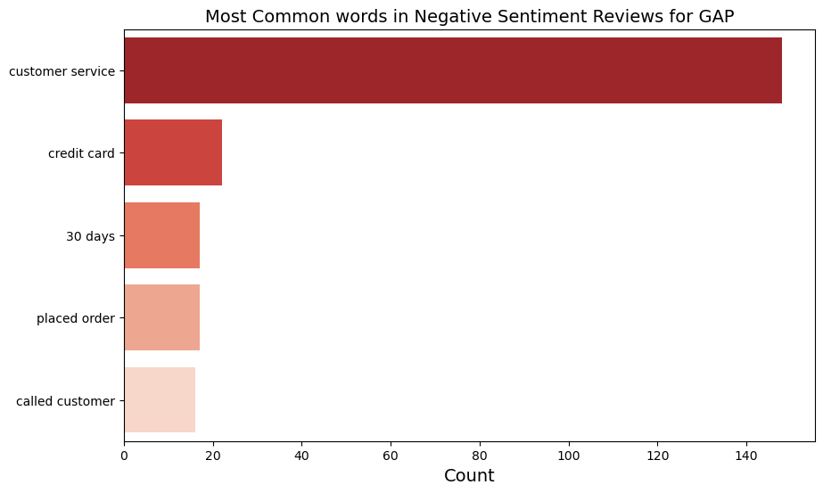
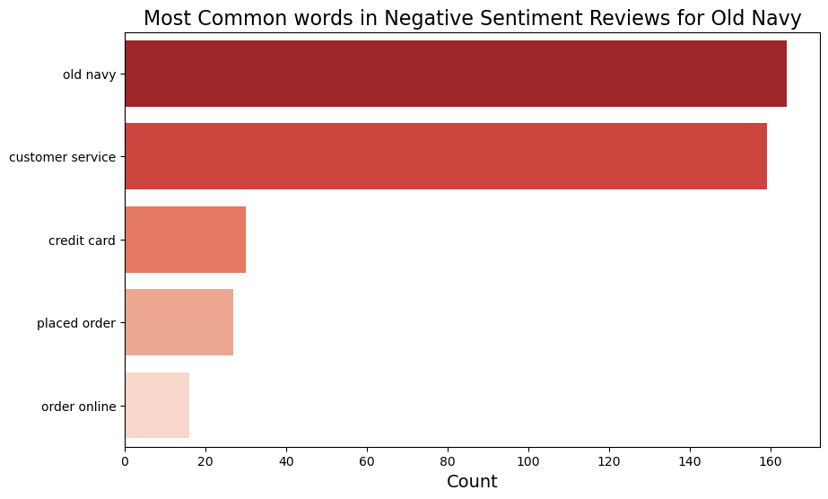
Analysis of Customer Reviews
Scrapped the data from Trust pilot for all the 3 brands GAP, Old Navy & Banana Republic
The graphs indicate that customer service is the primary driver of negative sentiment across both brands
To enhance customer engagement, a strategic focus on improving the overall customer experience, particularly in service interactions, could yield significant benefits.

Slide 13
The Impact of Big Data in Marketing
Big data and predictive analytics have transformed marketing by enabling more personalized customer engagement and data-driven decision-making.
Customer Segmentation and Personalization: Gap uses data to target marketing to specific customer groups based on preferences.
Demand Forecasting: Predictive analytics helps Gap anticipate fashion trends and manage inventory.
Budget Optimization: Gap allocates its marketing budget more efficiently by focusing on high-performing channels.
Customer Retention: Gap personalizes retention strategies by analyzing customer reviews and purchase behavior.
Forecasting
Optimization
Retention
Segmentation

Slide 14
The Balance of Art and Science in Marketing
Science Rules When:
• Targeting specific audiences
• Optimizing ad campaigns through A/B testing and ML algorithms
• Forecasting future trends based on historical data
Art Rules When:
• Developing emotionally resonant content
• Using design and aesthetics to enhance engagement
• Creating brand stories and unique product positioning
As data-driven marketing grows, the question arises: Where does creativity (art) fit?
Marketing success often requires both the precision of data (science) and the creativity of messaging (art).
Conclusion: Both data and creativity are vital for successful marketing. While data can guide strategy, creativity is key to crafting messages that resonate with consumers.

Slide 15
Recommendations
Use
Use the Google trend analysis and customer review analysis to market the top-selling and top-rated clothing items
Leverage
Leverage predictive analytics to optimize inventory management and reduce excess stock by adjusting production cycles in real-time.
Enhance
Enhance customer engagement by using sentiment analysis from social media and reviews to improve service interactions and personalize marketing.
Expand
Expand online distribution by integrating with third-party platforms like Amazon to capture new customer segments and gain valuable consumer behaviour insights.

Slide 16
Limitations
Data Bias: Insights from social media or trends reflects opinions from internet active users rather than representing the entire market
Misinterpretation: The insights from the data may reveal correlations and trends that could lead executives to assume a pattern in sales, when in reality, the cause may be an external factor, such as a pandemic.
Technological Limitations: Platforms constantly change algorithms and structure of their webpages; which could limit the data collected, leading to inconsistent insights.
Generalization: Insights obtained from data of one region may be not scalable to different geographic areas or customer segments with different behaviors or preferences.

Slide 17
Appendix

Slide 18
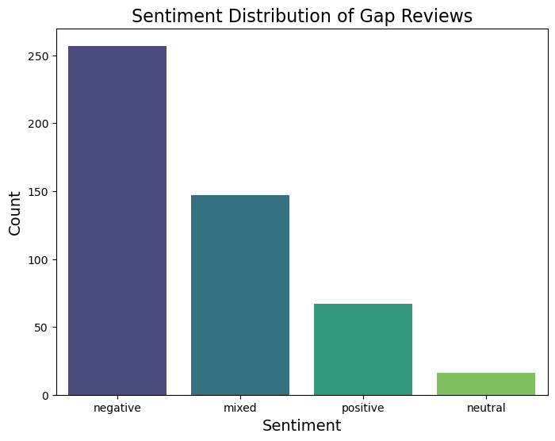
Review Analysis - GAP

Slide 19
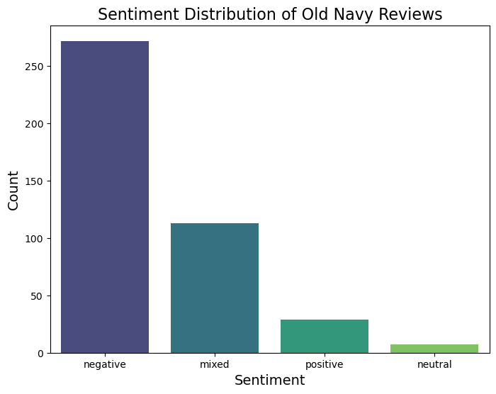
Review Analysis – Old Navy

Slide 20
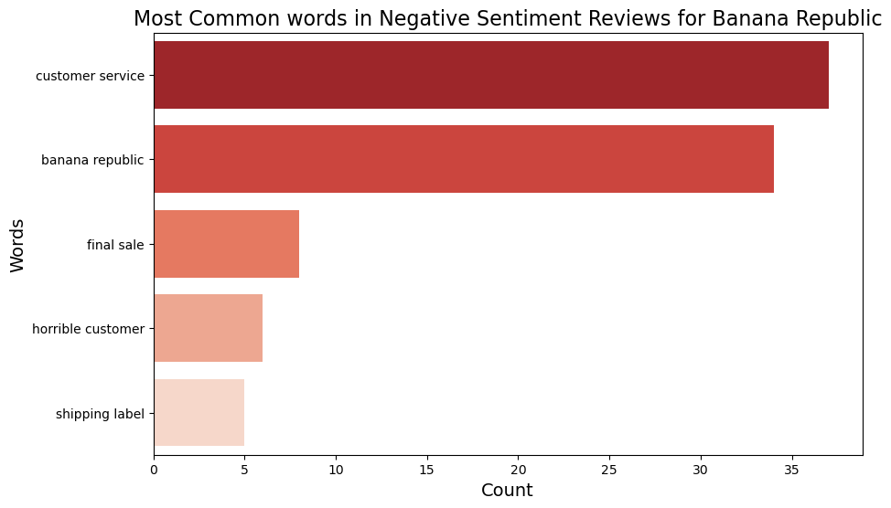
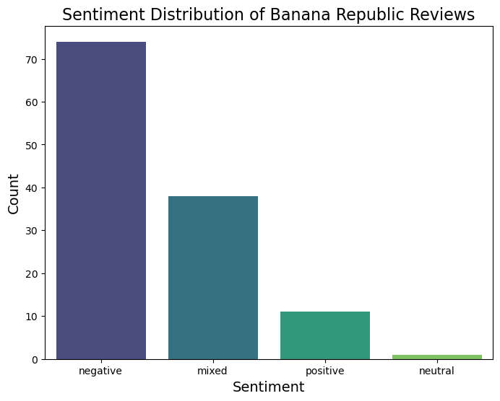
Review Analysis – Banana Republic

Slide 21
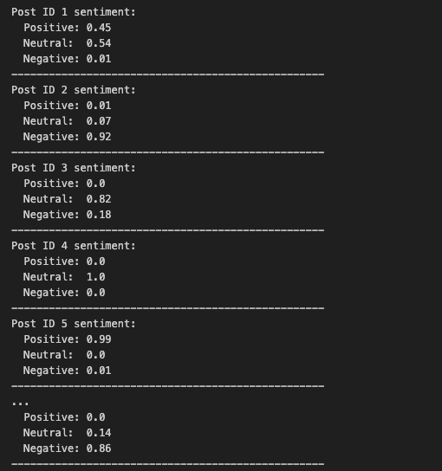
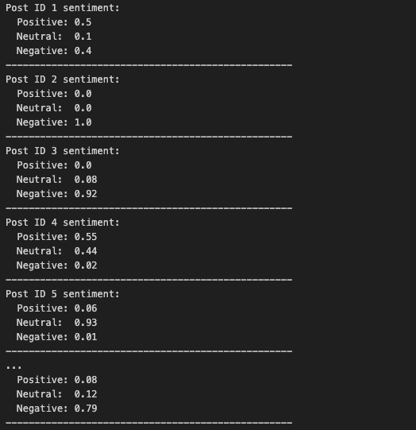
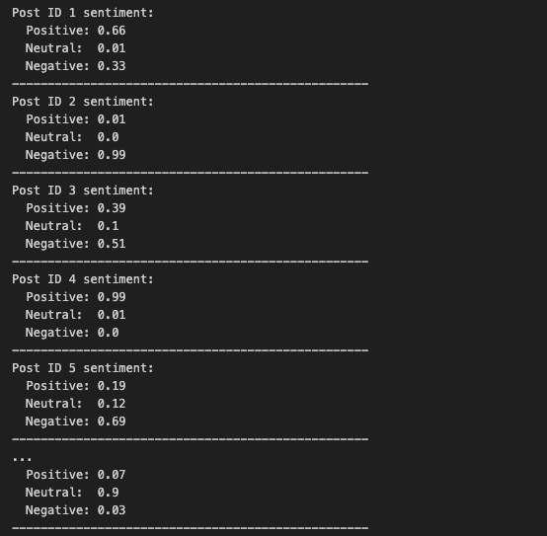
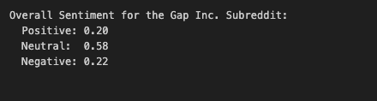
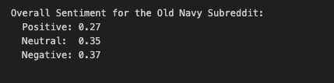

Reddit Analysis for All 3 brands
GAP Old Navy Banana Republic
Individual Sentiment for each post
Individual Sentiment for each post
Individual Sentiment for each post
Overall Sentiment for Gap Subreddit
Overall Sentiment for Old Navy Subreddit
Overall Sentiment for Banana Republic Subreddit

Slide 22
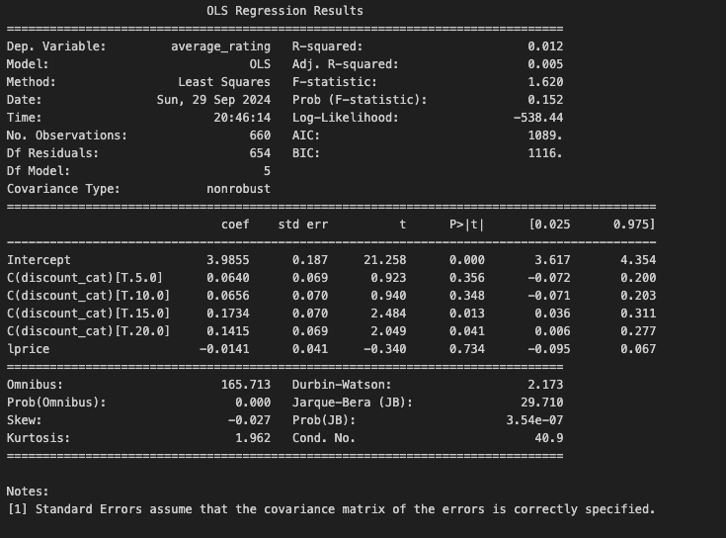
Regression Model
Comparing the relationship between Discount, Pricing & Average Rating for Zara

Slide 23
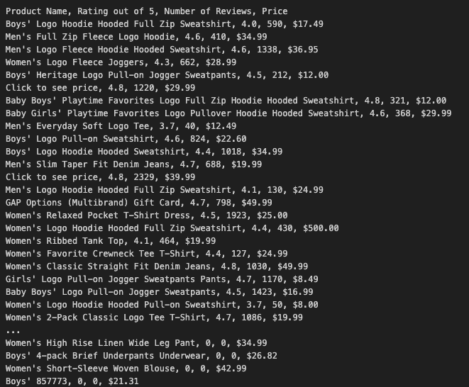
Amazon Analysis
Extracted the product names, Ratings, Number of reviews & Pricing data from Amazon for GAP products

Slide 24
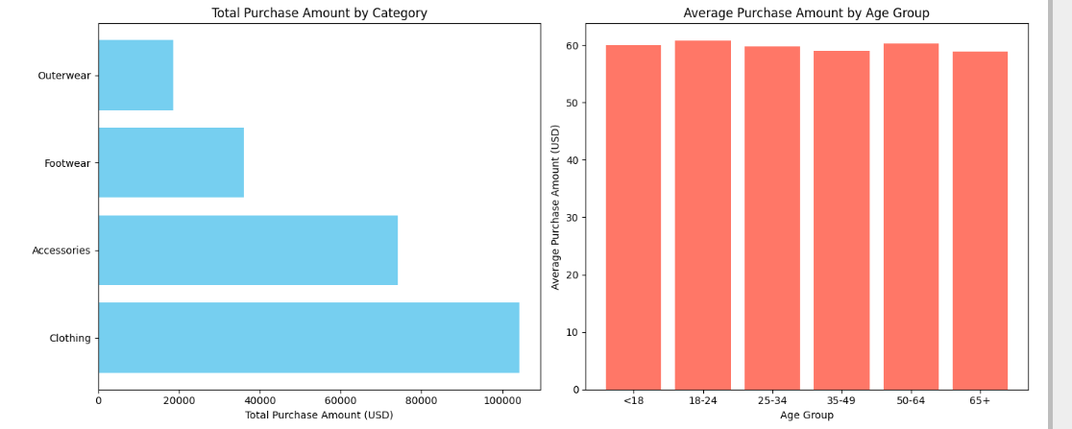
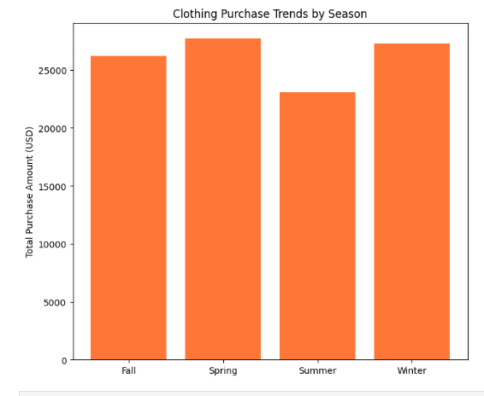
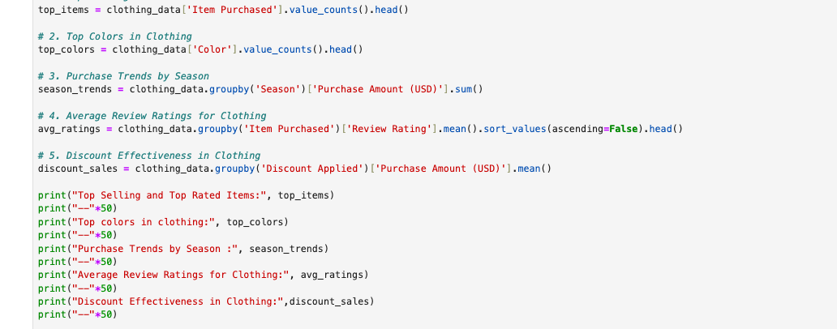
Google Trend Analysis
Analyzing the top trends in the Clothing category using Google trends.

Slide 25
THANK YOU

